Slide 1
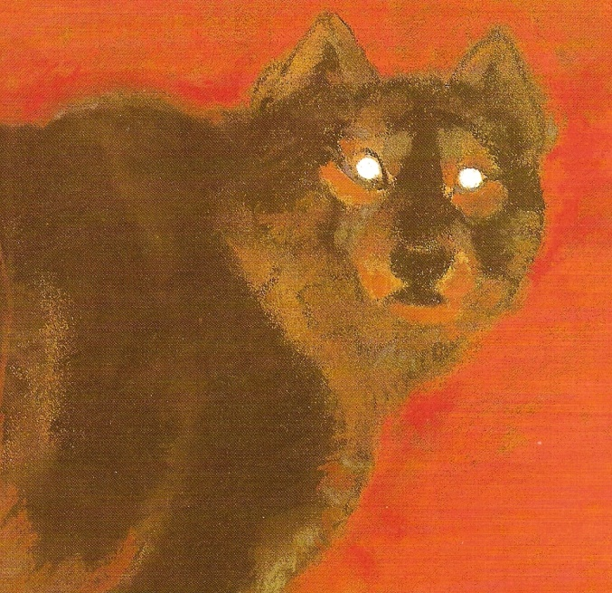
Comparing and Contrasting
Character’s Adventures
Part 2
Mrs. Talley’s Kindergarten
Russell Jones Elementary
February 22, 2012

Slide 2
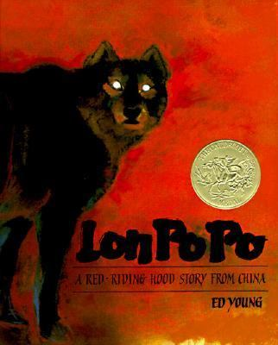
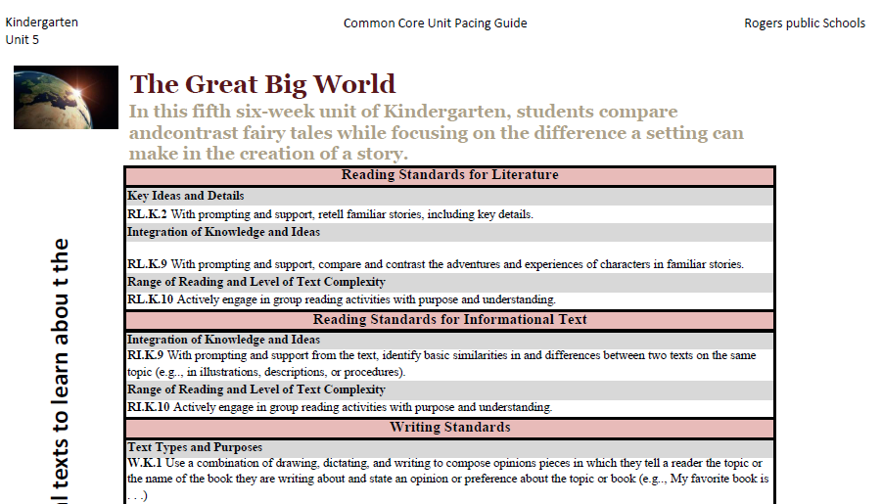
Mrs. Talley continued working with the standard and activity from the previous day’s lesson.
RL.K.9 With prompting and support, compare and contrast the adventures and experiences of characters in familiar stories.

Slide 3
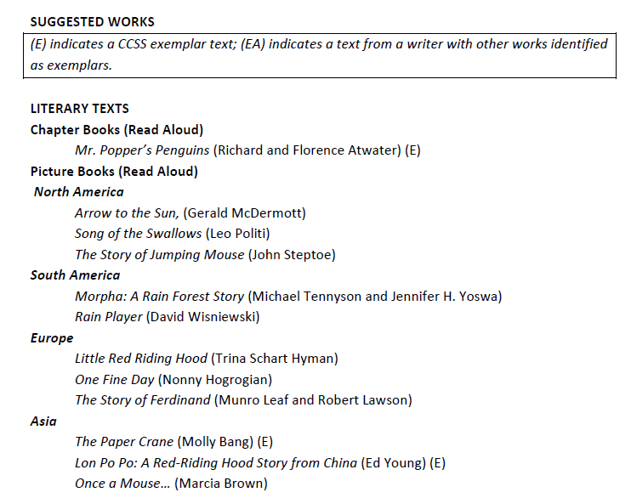
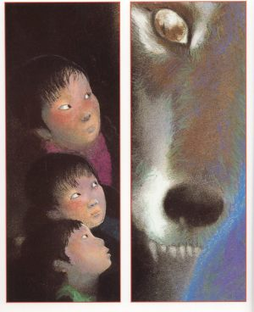
This lesson focused on finding the “adventure” in a story.
RL.K.9 With prompting and support, compare and contrast the adventures and experiences of characters in familiar stories.

Slide 4
Because many of her students are language learners,
Mrs. Talley planned to incorporate the following language objectives in her lesson:
Language Objectives:
Listening: Listen to literature from diverse cultures (ELPL.1.K-2.8)
Speaking: Respond appropriately- EL1 one or two word phrases, EL2 simple sentences (ELPL.1.K-2.8)
Reading: Answer questions (ELPR.4.K-2.4)
Writing: Apply strategies, when prompted, to move from oral
to written language (ELPW.7.K-2.4)

Slide 5
(2) Identifying Similarities and Differences
(7) Cooperative Learning
(3) Summarizing and Note Taking
(8) Setting Objectives and Providing Feedback
(4) Reinforcing Effort and Providing Recognition
(9) Generating and Testing Hypotheses
(5) Homework and Practice
(10) Cues, Questions and Advance Organizers
(6) Nonlinguistic Representations
GANAG gives students the opportunity to actively use the nine high-yield strategies.

Slide 6
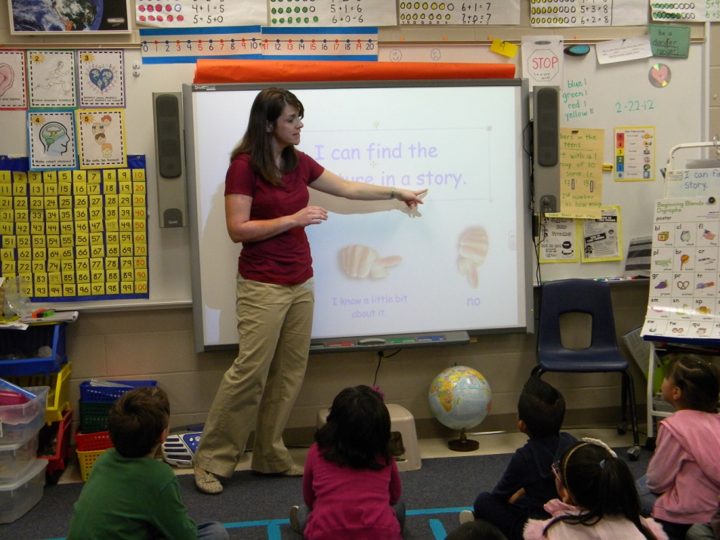
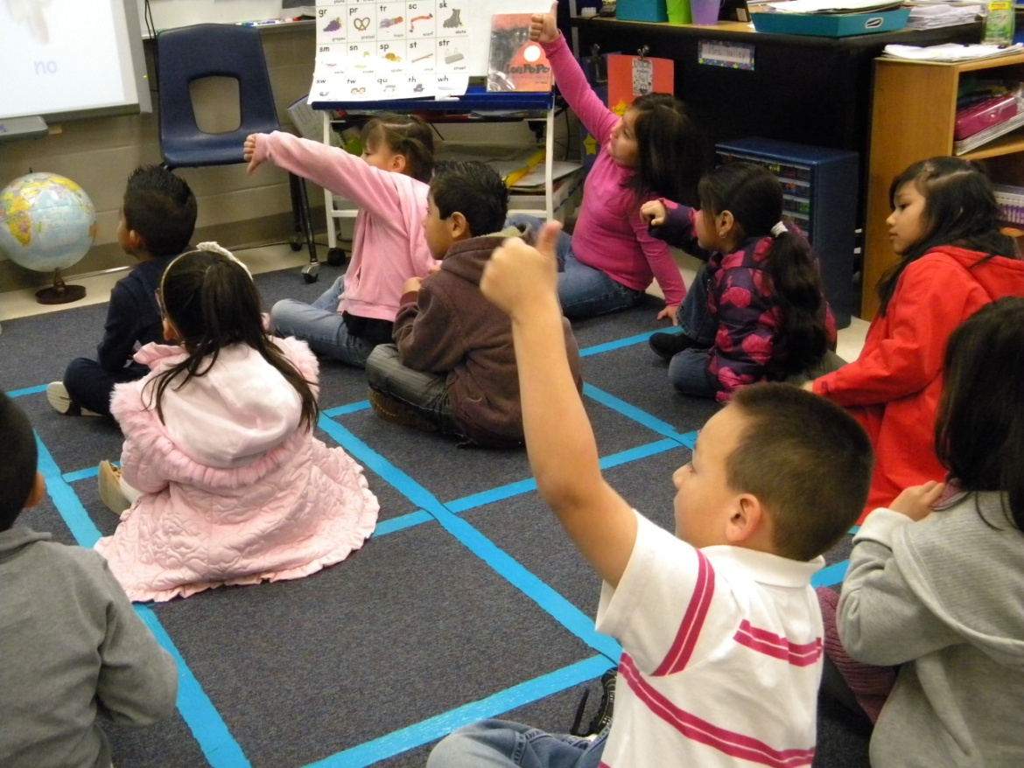
GOAL: I can find the adventure in a story.
Students scored themselves to the goal with a thumbs up or down.
(8) Setting Objectives and Providing Feedback

Slide 7
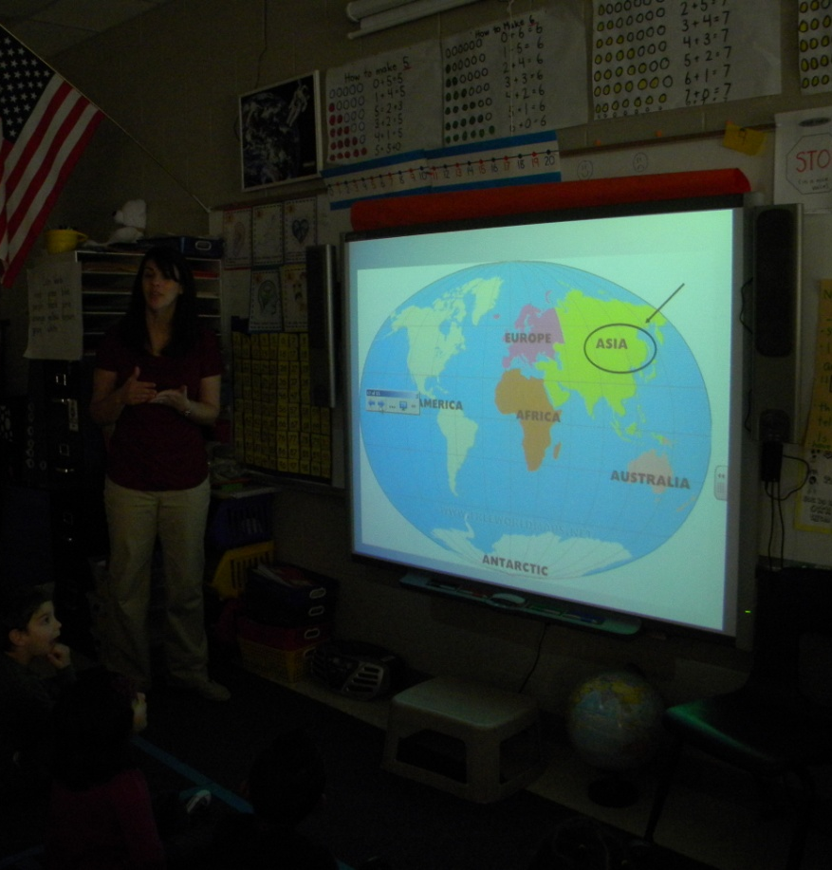
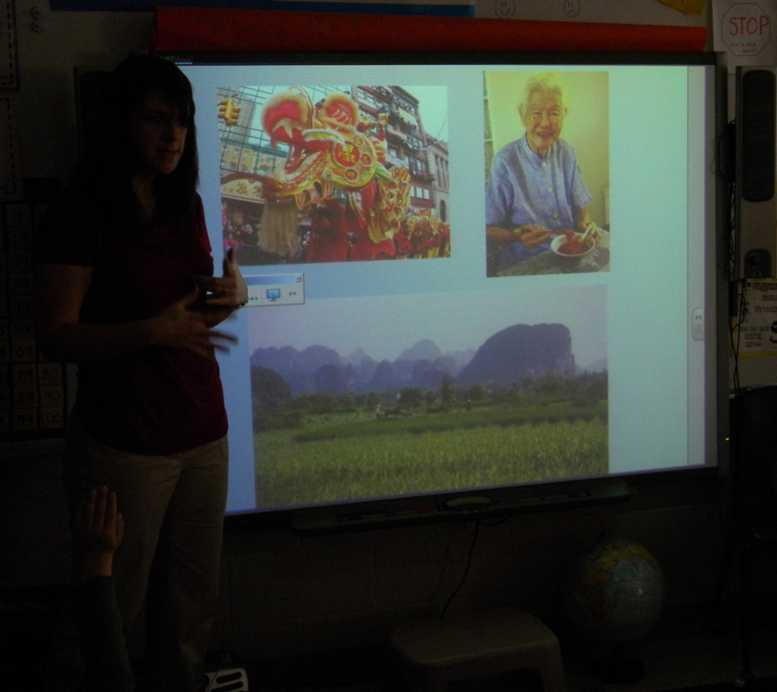
(6) Nonlinguistic Representations
Access Prior Knowledge
(7) Cooperative Learning
Mrs. Talley showed images from a previous lesson about Asia.
Turn and Talk- “What do you know about these pictures?”

Slide 8
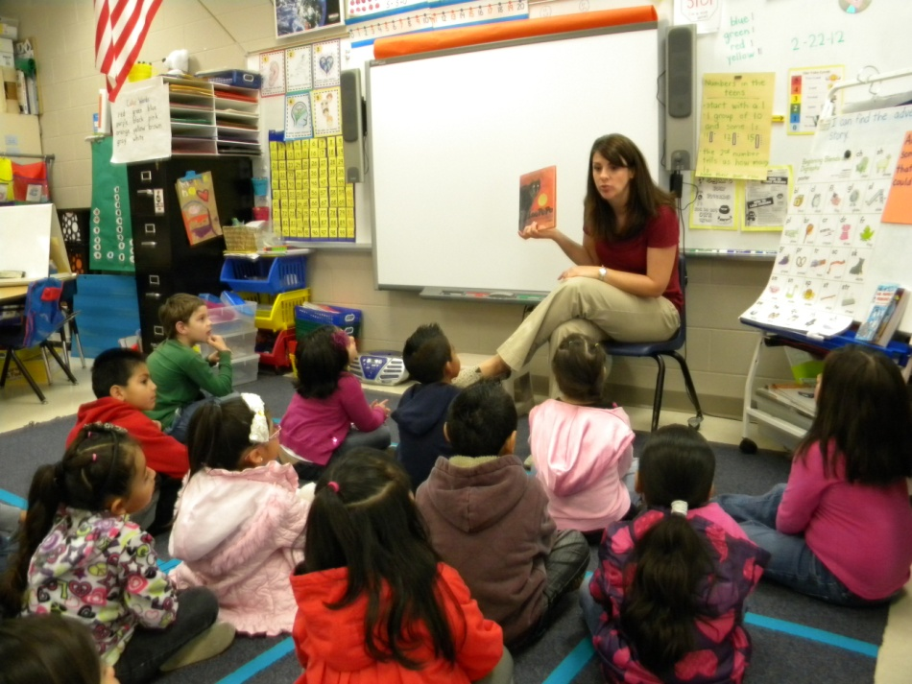
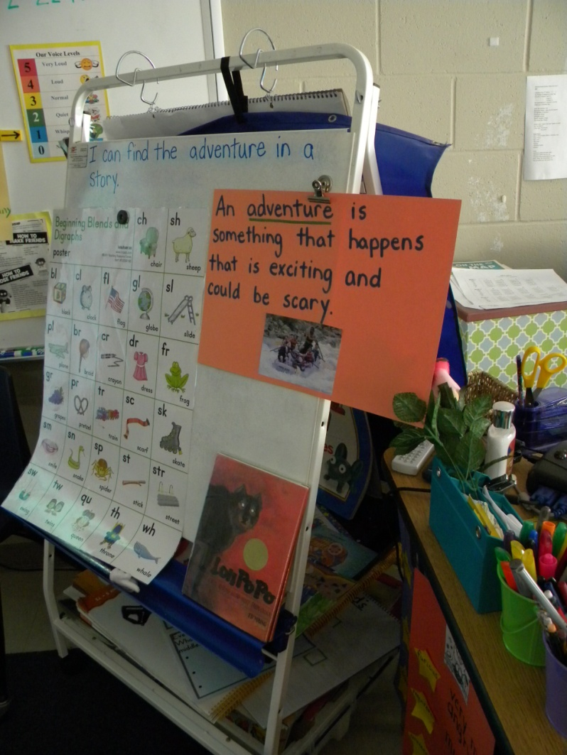
New Information
“Today we are going to read another story about a little girl who has an adventure with a wolf. The setting of this story is China which is on the continent Asia.”
The class reviewed the definition of an adventure.

Slide 9
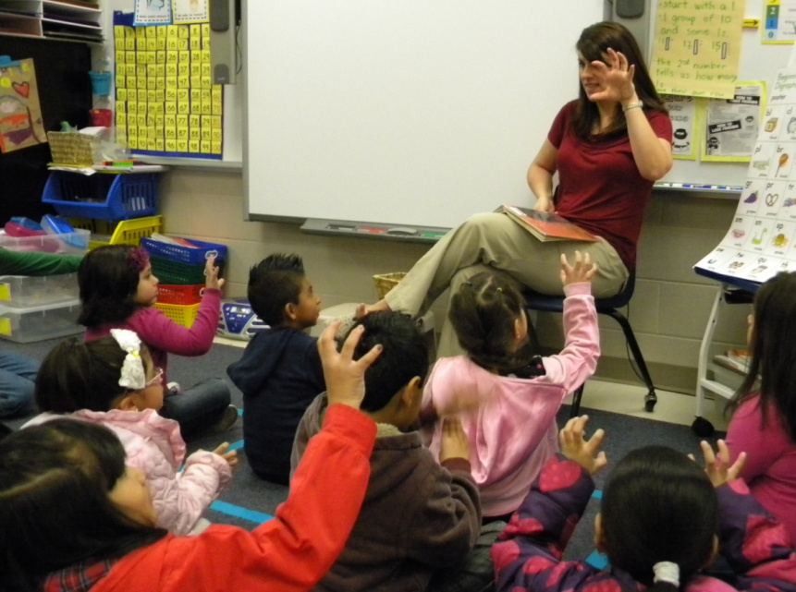
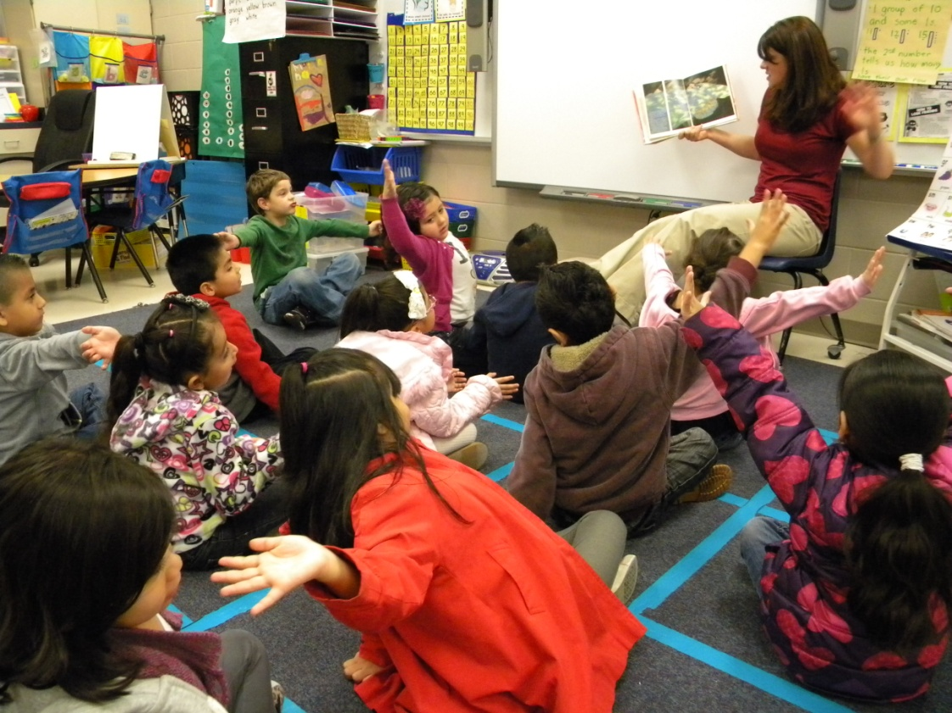
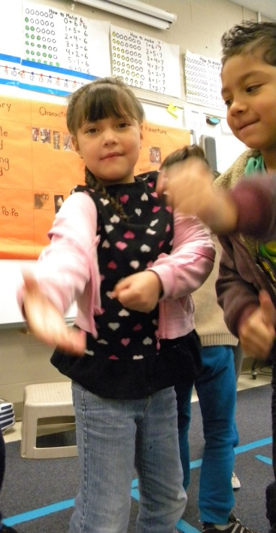
As Mrs. Talley read, she paused and
asked students to act out key vocabulary.
Claws
Pull with all your strength
Stretch
(6) Nonlinguistic Representations

Slide 10
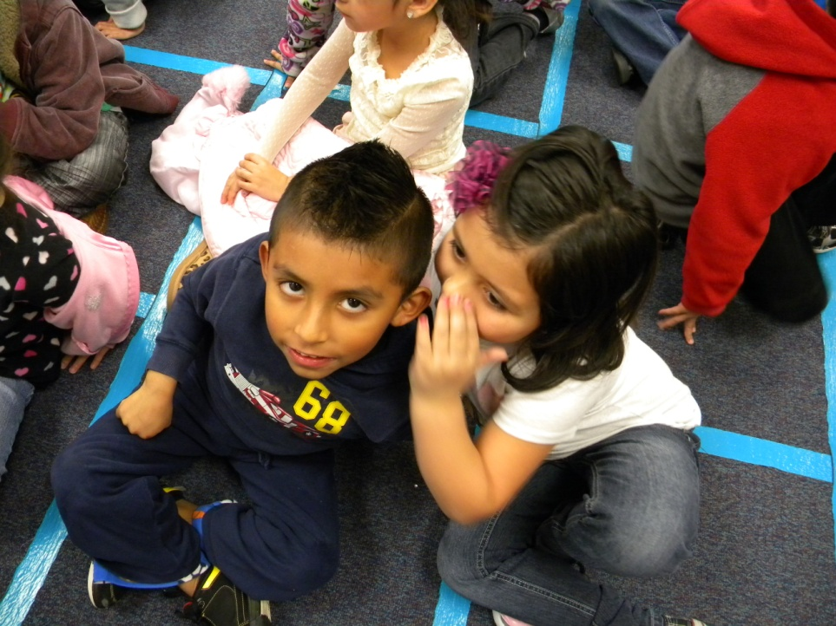
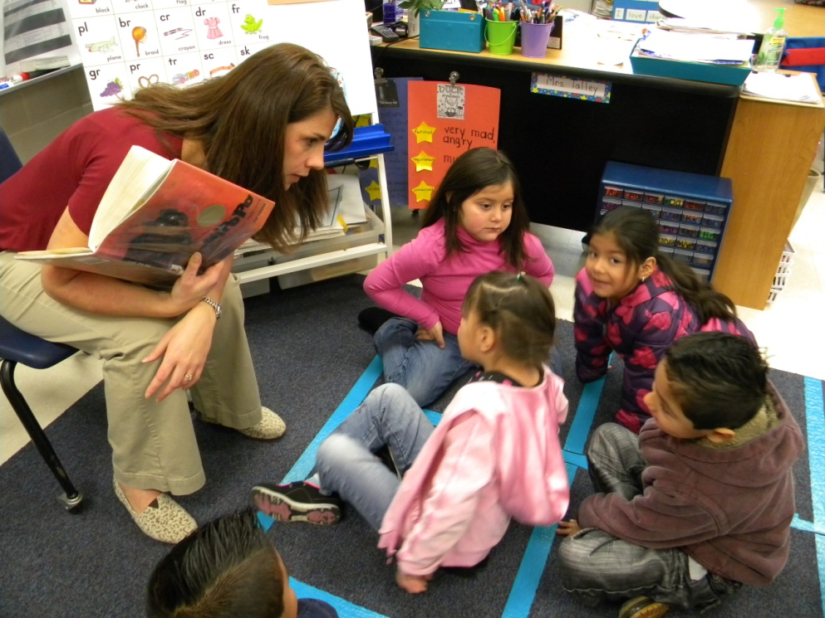
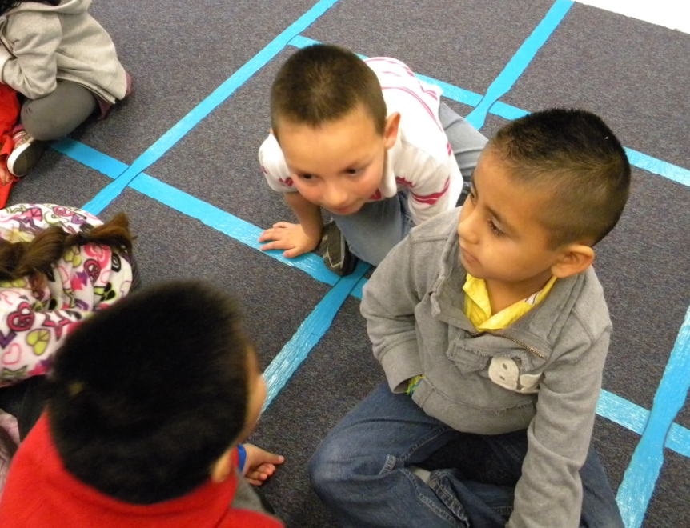
Application
“Can you find the adventure in the story? Turn and tell a friend about the adventure.”
(10) Cues, Questions and Advance Organizers

Slide 11
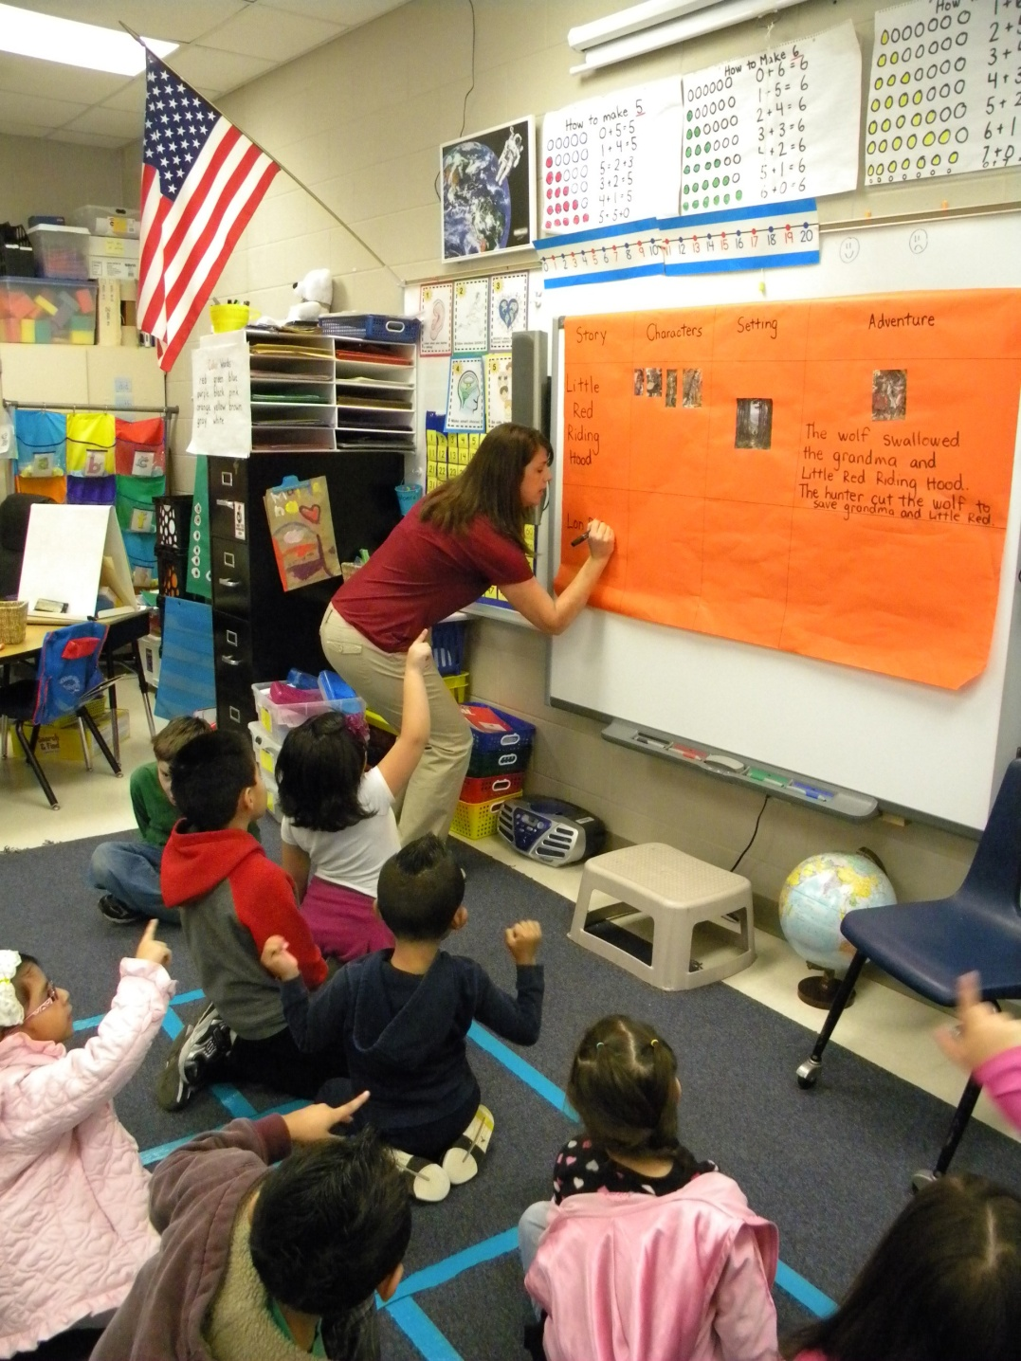
Story
Characters
Setting
Adventure
The class added information about Lon Po Po to the comparison matrix.
(3) Summarizing and Note Taking

Slide 12
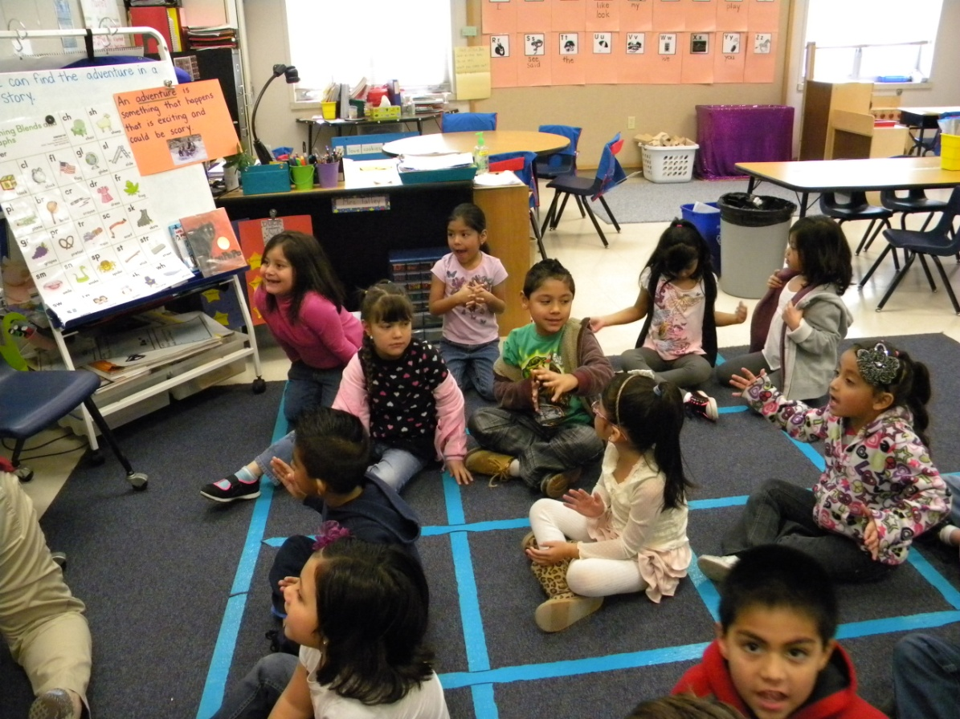
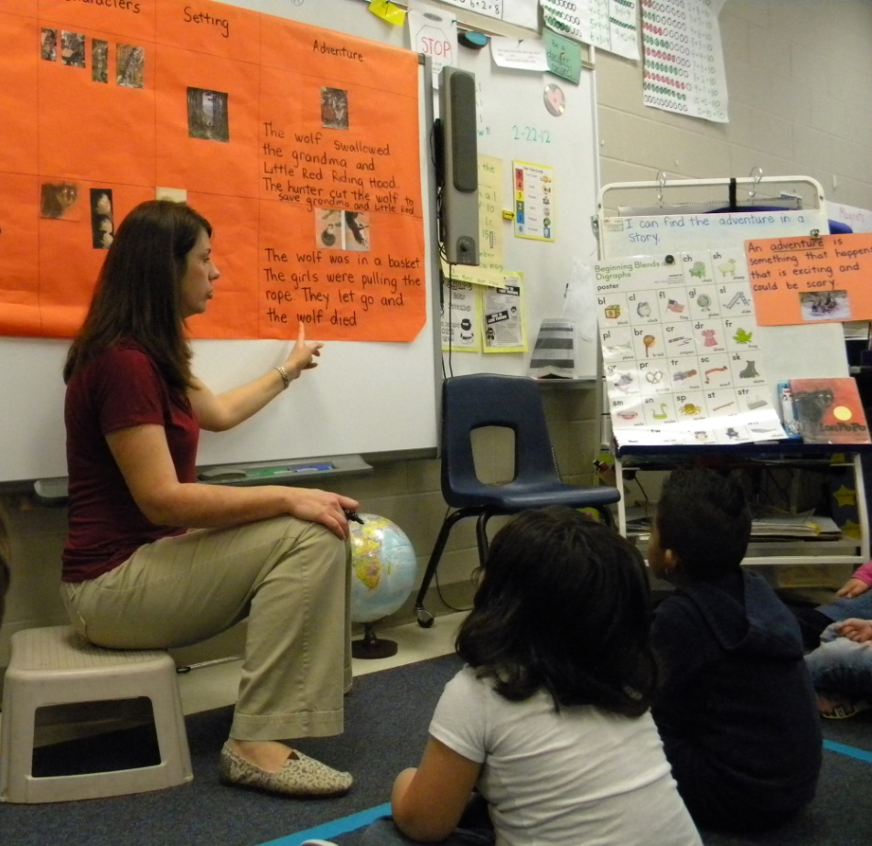
The wolf was in a basket. The girls were pulling the rope. They let go and the wolf died.
The students helped Mrs. Talley compose the message for the adventure.

Slide 13
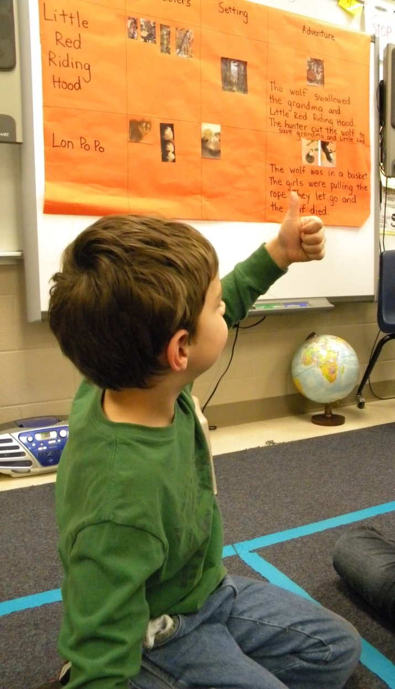
GOAL: I can find the adventure in a story.
Students revisited the goal and scored themselves again with a thumbs up or down.
Mrs. Talley praised students for their hard work.
(4) Reinforcing Effort and Providing Recognition
(3) Summarizing and Note Taking

Slide 14
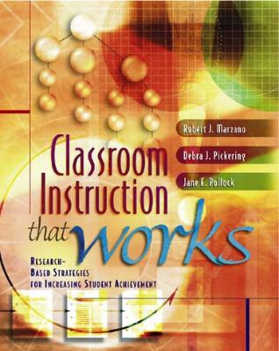
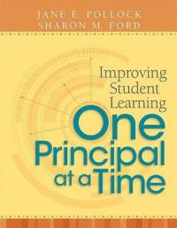
Marzano, R. J., Pickering, D. J., & Pollock, J. E. (2001). Classroom instruction that works: Research-based strategies for increasing student achievement. Alexandria, VA: Association for Supervision and Curriculum Development.
Pollock, J. E. (2007). Improving student learning one teacher at a time. Alexandria, VA: Association for Supervision and Curriculum Development.
Pollock, J. E., & Ford, Sharon M. (2009). Improving student learning one principal at a time. Alexandria, VA: Association for Supervision and Curriculum Development.

